Slide 1

Modules and Packages

Slide 2
Bulit-in Modules ,Importing
The Python interactive shell has a number of built-in functions.
They are loaded automatically as a shell starts and are always available, such as print() and input() for I/O, number conversion functions int(), float(), complex(), data type conversions list(), tuple(), set(), etc.

Slide 3
built-in modules.
In addition to built-in functions, a large number of pre-defined functions are also available as a part of libraries bundled with Python distributions.
These functions are defined in modules are called built-in modules.

Slide 4
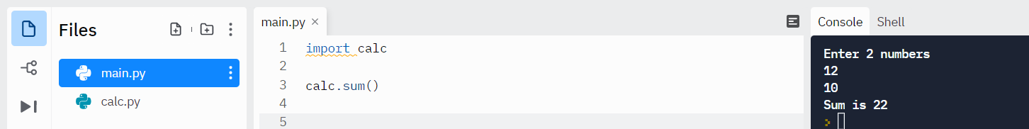
Example
Consider a module to be the same as a code library.
A file containing a set of functions you want to include in your application.
A module is a file containing Python definitions and statements. A module can define functions, classes, and variables. A module can also include runnable code. Grouping related code into a module makes the code easier to understand and use. It also makes the code logically organized.

Slide 5
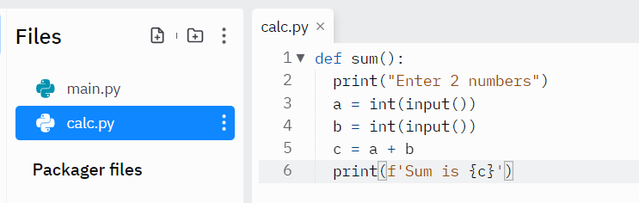
Code in calc file

Slide 6
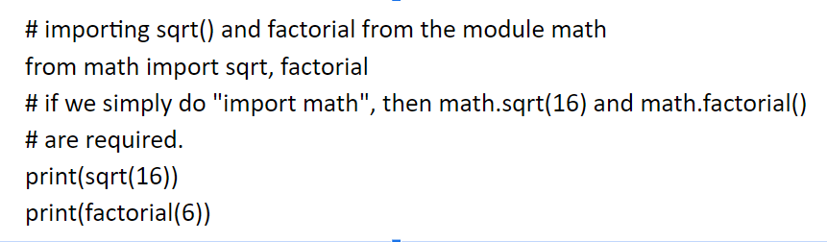
continue
When the interpreter encounters an import statement, it imports the module if the module is present in the search path. A search path is a list of directories that the interpreter searches for importing a module.
The from import Statement
Python from statement lets you import specific attributes from a module.

Slide 7
continue
The from import * Statement
The * symbol used with the from import the statement is used to import all the names from a module to a current namespace.
Syntax:
from module_name import *
The use of * has it’s advantages and disadvantages. If you know exactly what you will be needing from the module, it is not recommended to use *, else do so.

Slide 8

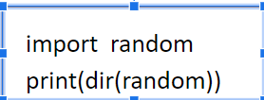
The dir() built-in function returns a sorted list of strings containing the names defined by a
module.
The list contains the names of all the modules, variables, and functions that are
defined in a module.

